Slide 1
Syntax Analysis
Part I

Slide 2
Ambiguity – Operator Precedence
Ambiguous grammars (because of ambiguous operators) can be disambiguated according to the precedence and associativity rules.
E → E+E | E*E | E^E | id | (E)
disambiguate the grammar
precedence: ^ (right to left)
* (left to right)
+ (left to right)
E → E+T | T
T → T*F | F
F → G^F | G
G → id | (E)
⇓

Slide 3
Ambiguity – Associativity
If the same precedence operators are in production, we must examine their associativity.
If the associativity is left to right, we must initiate a left recursion in the production. The parse tree will be left-recursive and grow on the left side.
  +, -, *, and / are left associative operators.
If the associativity is right to left, we must prompt the appropriate recursion in the productions. The parse tree will also be right-recursive, growing on the right side.
  ^ denotes a right associative operator.

Slide 4
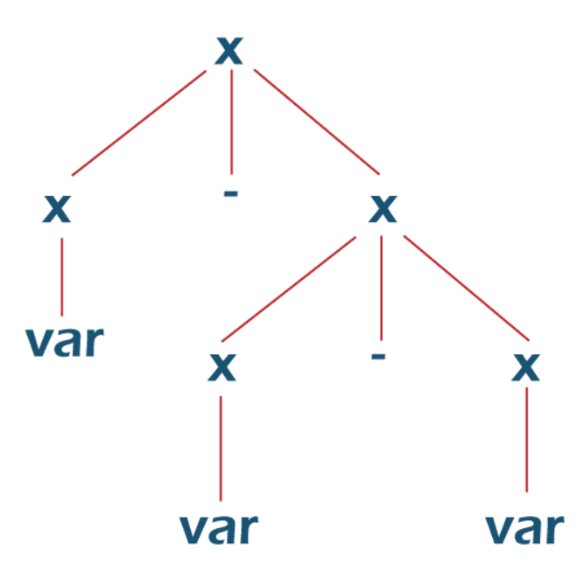
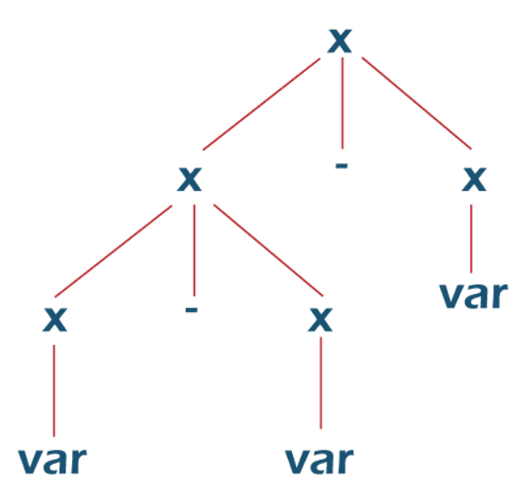
Ambiguity – Associativity
Grammer:
X -> X - X
X -> var/const
String: “a-b-c”

Slide 5
Ambiguity – Associativity
Grammer:
X -> X - P/P
P -> var/ const
String: “a-b-c”
Corrected Grammer:
X -> X - P
X - X - P
P - P - var
var - var - var
a-b-c
String: “a-b-c”

Slide 6
Left Recursion
A grammar is left recursive if it has a non-terminal A such that there is a derivation
A ⇒ Aα for some string α
Top-down parsing techniques cannot handle left-recursive grammars.
So, we have to convert left-recursive grammar into an equivalent grammar which is not left-recursive.
The left-recursion may appear in a single step of the derivation (immediate left-recursion), or may appear in more than one step of the derivation.
+

Slide 7
Eliminate Left-Recursion
A → A α | β where β does not start with A
⇓ eliminate immediate left recursion
A → β A′
A′ → α A ′ | ε an equivalent grammar

Slide 8
Immediate Left-Recursion - Example
E → E+T | T
T → T*F | F
F → id | (E)
⇓ eliminate immediate left recursion
E → TE′
E′ → +TE′ | ε
T → FT′
T’ → *FT′ | ε
F → id | (E)

Slide 9
Immediate Left-Recursion
In general,
A → A α₁ | ... | A α_{m} | β₁ | ... | β_{n} where β₁ ... β_{n} do not start with A
⇓ eliminate immediate left recursion
A → β₁ A′ | ... | β_{n} A ′
A′ → α₁ A′ | ... | α_{m} A′ | ε an equivalent grammar

Slide 10
Left-Recursion -- Problem
A grammar cannot be immediately left-recursive, but it still can be
left-recursive.
By just eliminating the immediate left-recursion, we may not get
a grammar which is not left-recursive.
S → Aa | b
A → Ac |Sd | ε This grammar is not immediately left-recursive,
but it is still left-recursive.
S ⇒ Aa ⇒ Sda or
A ⇒ Sd ⇒ Aad causes to a left-recursion
So, we have to eliminate all left-recursions from this grammar

